Slide 1
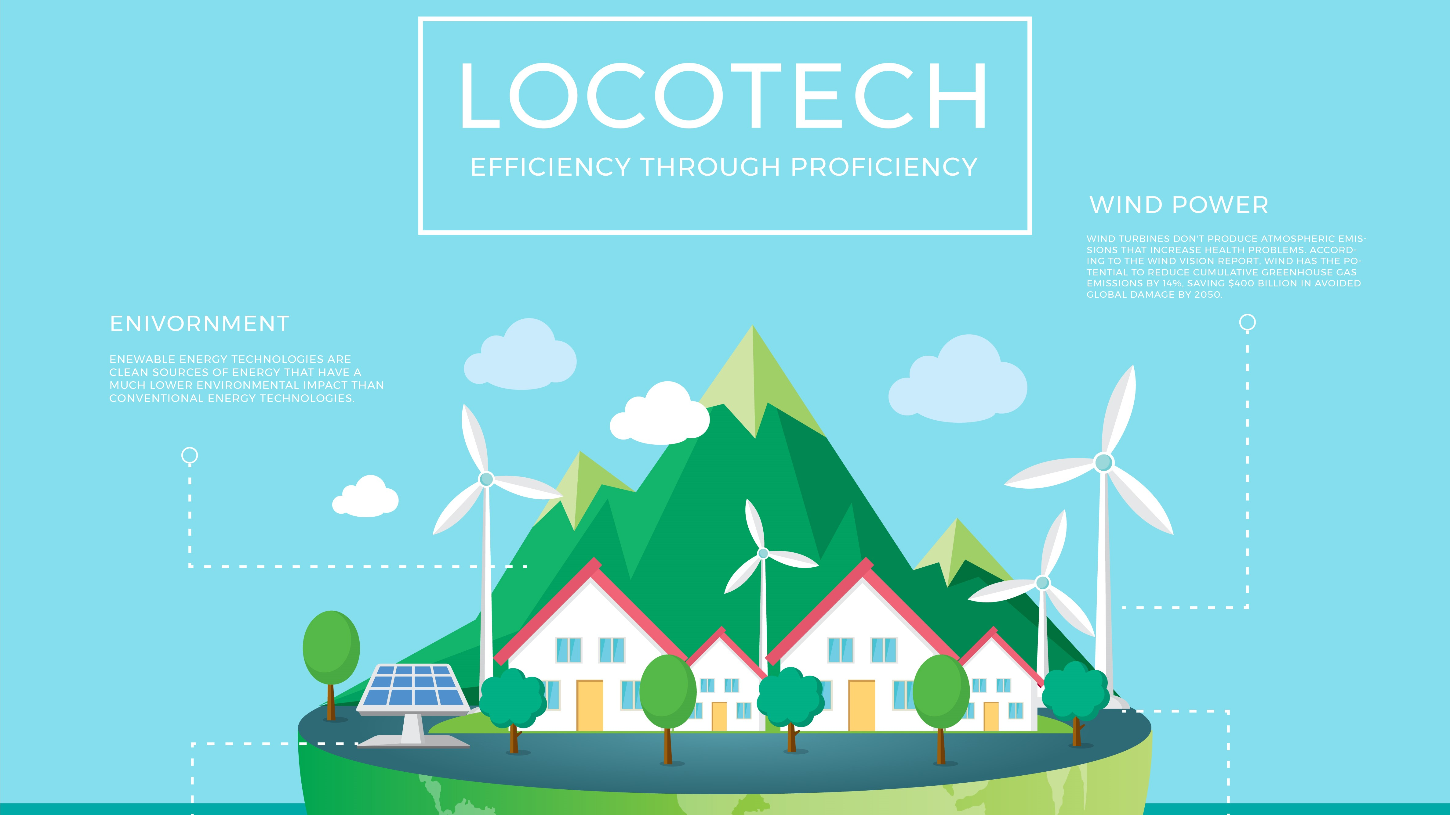

Slide 2

THE EARTH AND US: LIVE SMART
We introduce the model of next-gen villages that efficiently integrates data through smart technologies and automatizes basic agricultural processes.
We ensure that the benefits of smart planning are accessible to all population.

Slide 3

HELLO!
We Are LOCOTECH
We are here to offer you low cost solutions to high cost problems. You can find us at github.com/Locotech

Slide 4
NEXT-GEN COMMUNITY
Cost-effective and resource-effective tools and plans for greater global impact.

Slide 5
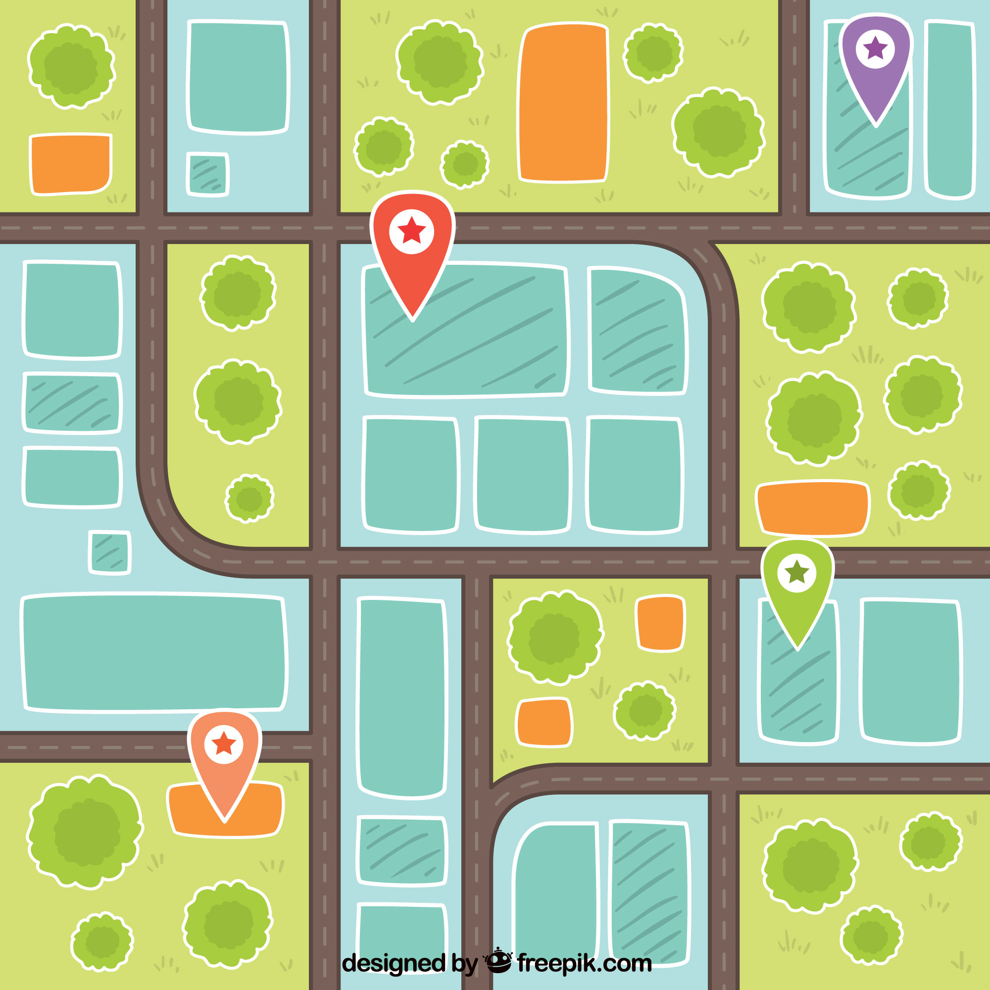
OUR MODEL

Slide 6

DATA COLLECTION

Slide 7
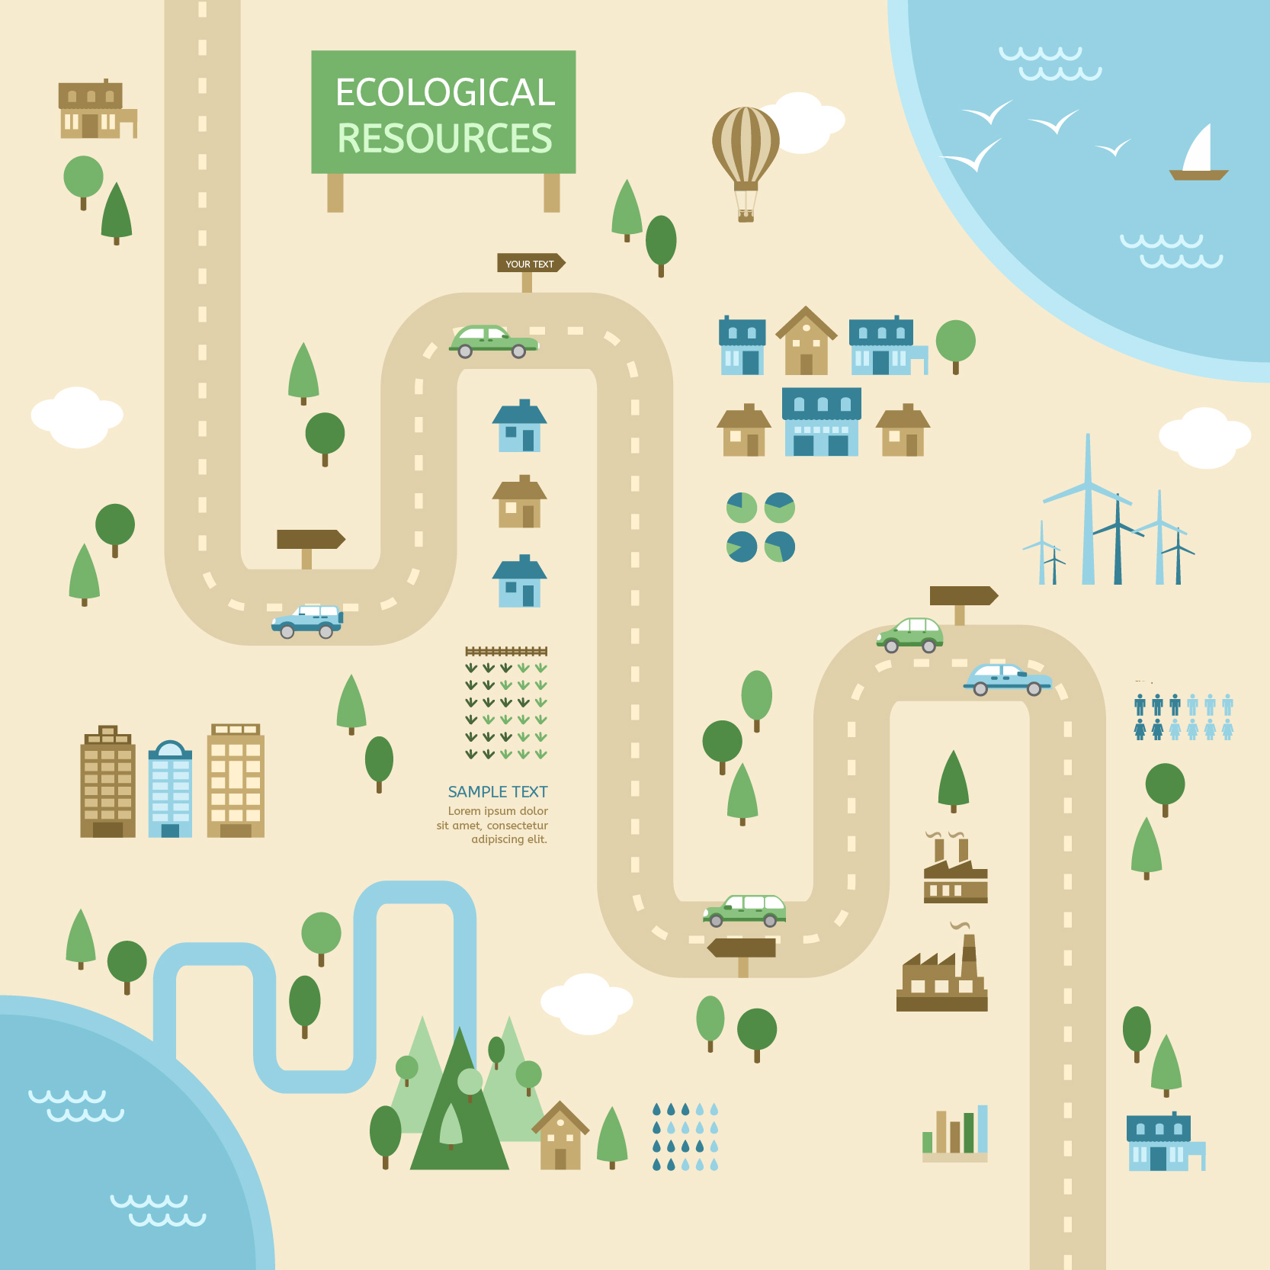
DATA ASSIMILATION

Slide 8
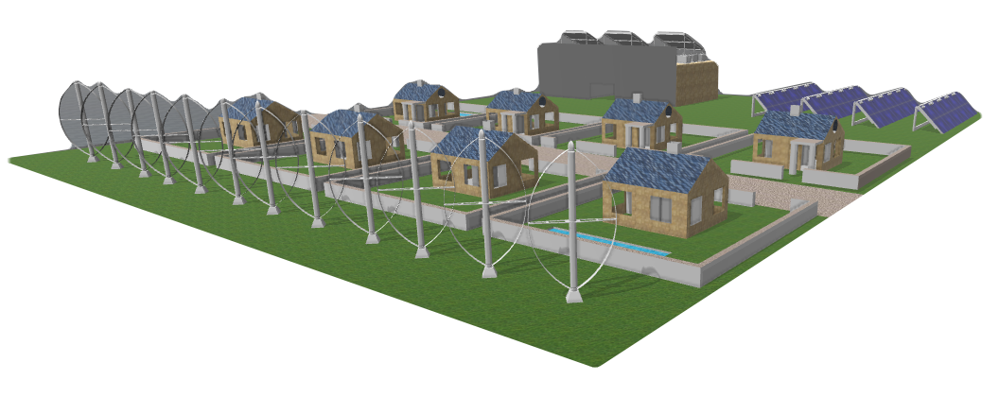
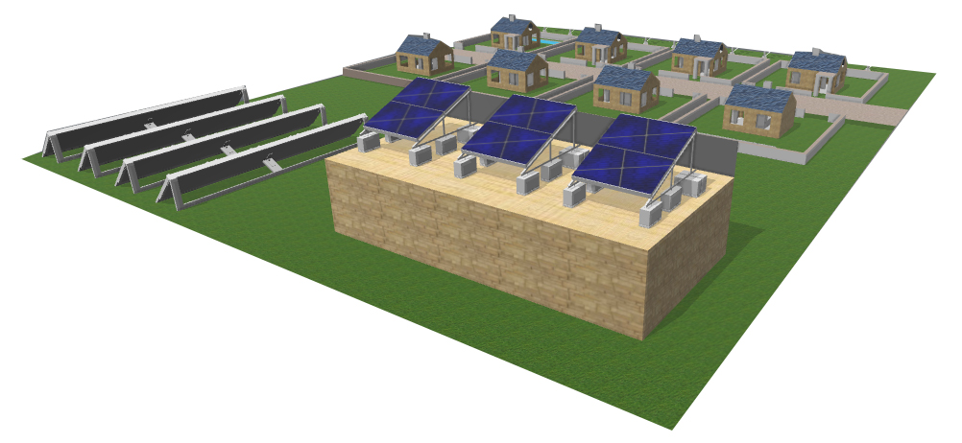
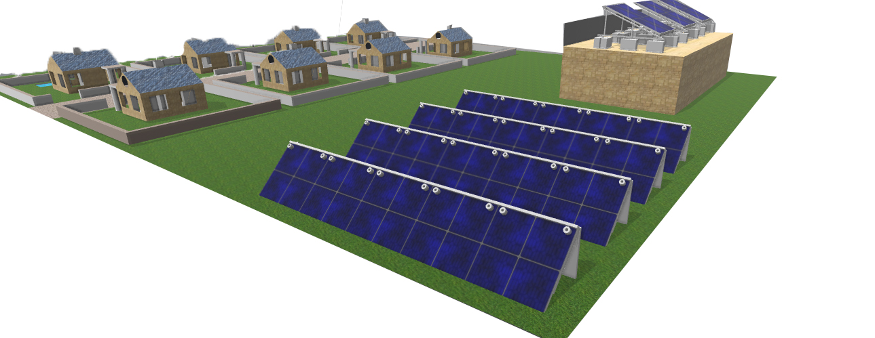
RESOURCE EFFECTIVE SOLUTIONS

Slide 9
1.
WHAT DO WE AIM FOR?
Let’s start with finding out our main goals!

Slide 10
The greatest threat to our planet is the belief that someone else will save it.
- Robert Swan

Slide 11
OUR SOLUTION INVOLVES THREE DIMENSIONS.
Economic (production boosting mechanisms)
Social (sustainable human settlement planning)
Environmental (adaptation to climate change)

Slide 12
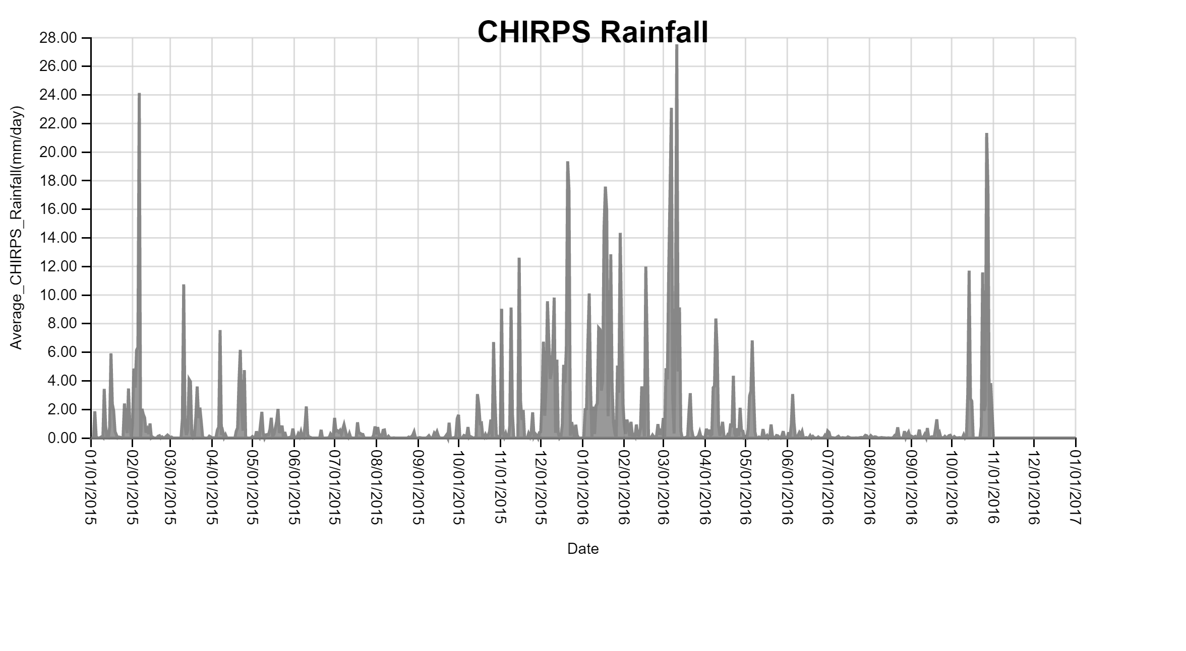
ENVIRONMENTAL PROBLEMS
Notes:
Heavy Precipitation. In recent years, a higher percentage of precipitation in the United States has come in the form of intense single-day events. The prevalence of extreme single-day precipitation events remained fairly steady between 1910 and the 1980s but has risen substantially since then. Nationwide, nine of the top 10 years for extreme one-day precipitation events have occurred since 1990. The occurrence of abnormally high annual precipitation totals (as defined by the National Oceanic and Atmospheric Administration) has also increased.
Half of the world's population currently live­s in urban areas; yet these urban areas make up only 2 percent of the world's land and spend three-quarters of the world's resources [source: MIT].

Slide 13
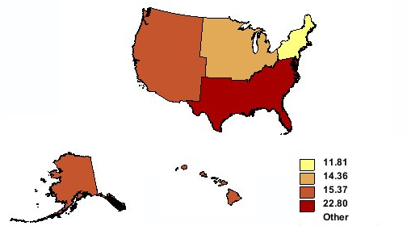
ENVIRONMENTAL DAMAGES

Slide 14
ADVANTAGES OF RENEWABLE ENERGY SOURCES
Renewables are great for our energy portfolio because they are inexhaustible and won’t pollute the planet for us or those of future generations by emitting toxic chemicals and gases.
Every town has access to sunlight, wind, and the geothermal power, so harnessing these sources could be a great democratizing force, offering affordable and plentiful power to everyone

Slide 15
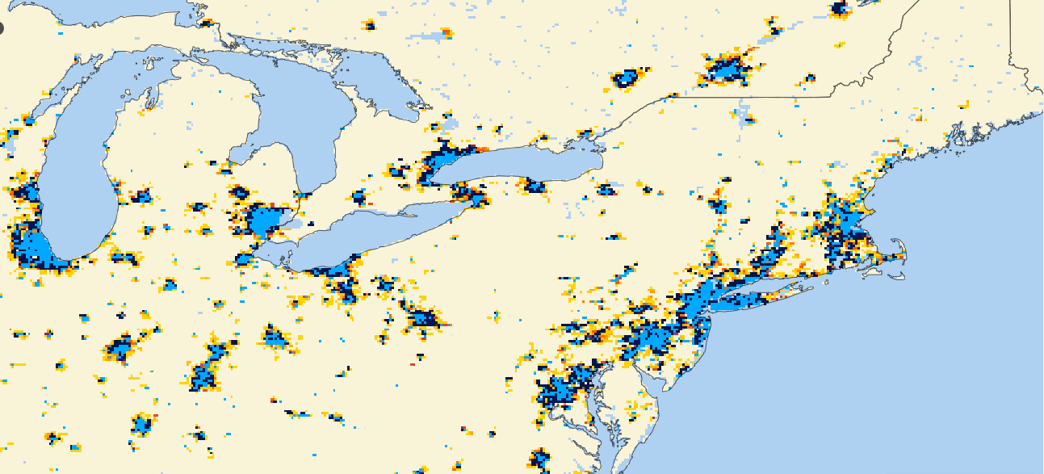
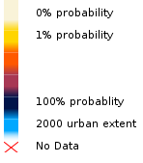
PROBABILITIES OF URBAN EXPANSION TO 2030

Slide 16
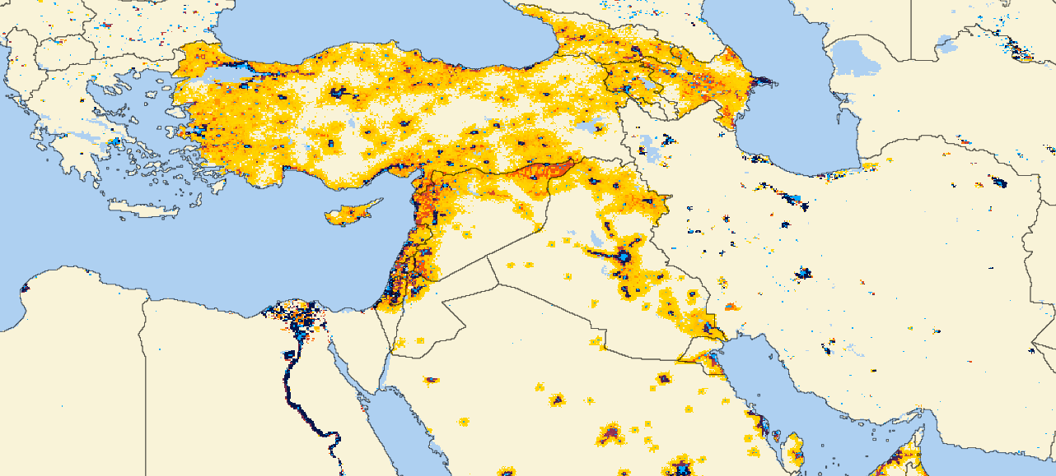
PROBABILITIES OF URBAN EXPANSION TO 2030

Slide 17
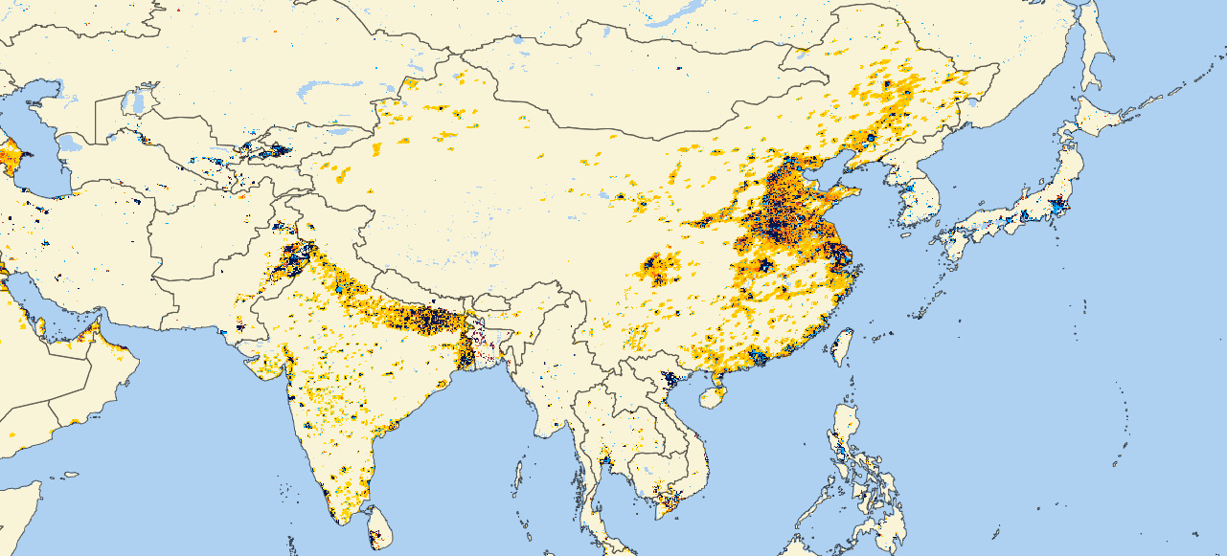
PROBABILITIES OF URBAN EXPANSION TO 2030

Slide 18
ADVERSE EFFECTS OF URBANIZATION
Since many people migrate to cities it results in scarcity of houses which in turn results in development of slums.
Urbanization leads to shift of working population from agriculture to industries and due to this there is fall in agriculture produce which results in fall in food production
Factories are most visible symbols of urbanization. Due to emissions of harmful gases and smoke from factories and vehicles, air pollution results.

Slide 19

LOCOTECH ENSURES AGRICULTURAL RENAISSANCE
These mechanisms will lead to shift of working population from harmful factories to ecologically friendly agricultural jobs, which will result in increase in food production and will meet the demand.

Slide 20
260,000
Employed by the solar industry! The industry grew 53% in the last four years!

Slide 21
1,300,000 users
97%
In 2016, a new solar installation was completed every 84 seconds
growth in Photovoltaic (PV) market over 2015

Slide 22
HELP THE EARTH ONE INNOVATION AT A TIME
INNOVATION
LOCOTECH
ECOLOGY

Slide 23

MOBILIZED CONTROL
Worldwide access.

Slide 24

ACCESSIBILITY

Slide 25
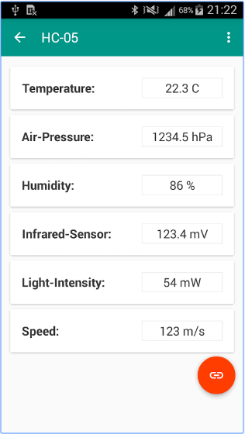
MOBILE CONTROL
Place your screenshot here
Get instant access to filtered monitoring information about your territory.

Slide 26
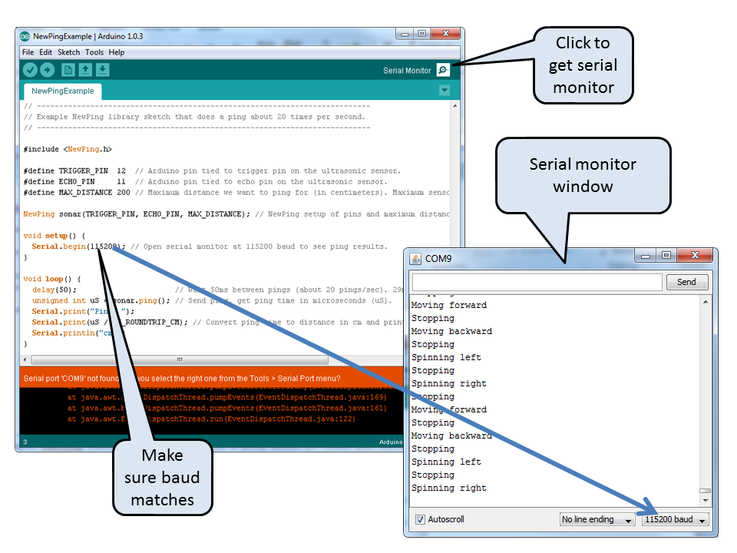
DESKTOP CONTROL
Place your screenshot here
Get informed about the current state of your territory on the device of your choice!

Slide 27
THANKS!
Any questions?
You can find us at github.com/Locotech

